Slide 1
Computer Networks
Wired LAN -Ethernet
S.V.Jansi Rani
Associate Professor / CSE

Slide 2
Agenda
Ethernet
Standard Ethernet
Fast Ethernet
Gigabit Ethernet

Slide 3



Slide 4
Ethernet Protocol
IEEE Project 802 – standards - intercommunication among equipment's from variety of manufacturers.
It is not replacement of OSI or TCP/IP but way of specifying functions of PL and DL of major LAN protocols
Ethernet supports high transmission rate and can be upgraded to demand – no need to switch to another tech - successful

Slide 5
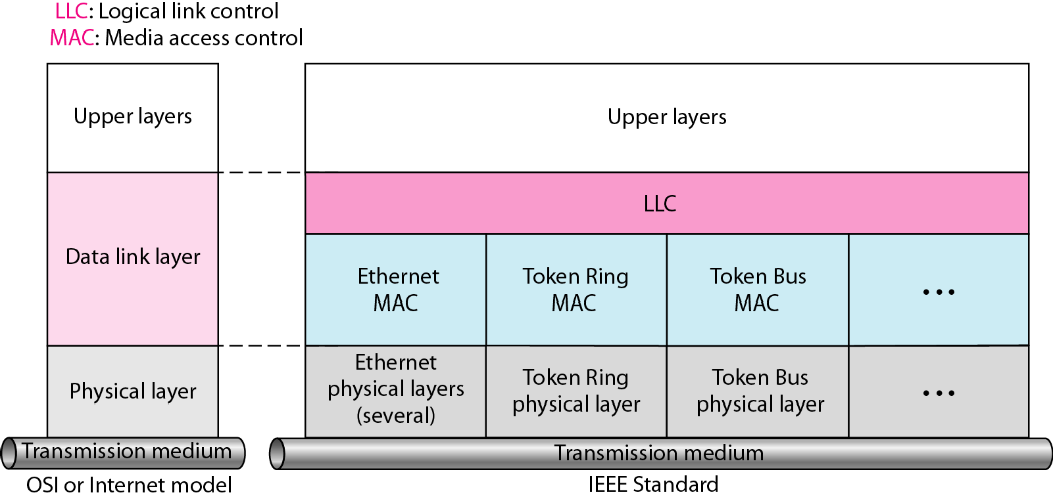
IEEE standard for LANs

Slide 6
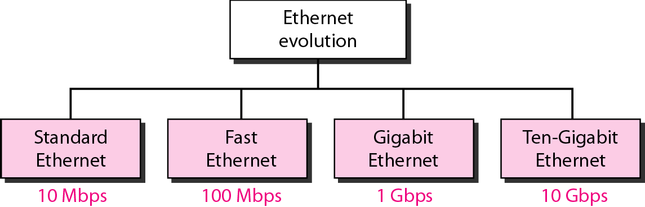
Ethernet evolution through four generations

Slide 7
STANDARD ETHERNET
Ethernet LAN was developed in 1970’s by Robert Metcalfe and David Boggs.
Data rate is 10Mbps
Characteristics:
Connectionless and unreliable service
Error detected by CRC
Frame ignored upon error

Slide 8
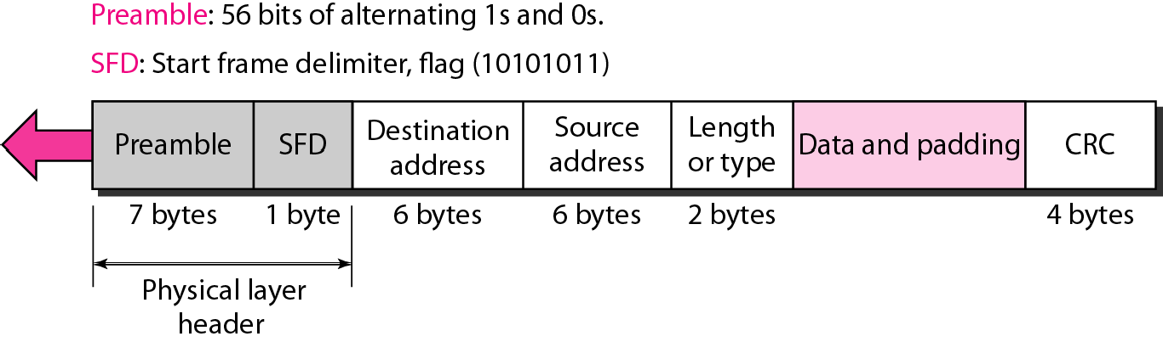
802.3 MAC frame

Slide 9
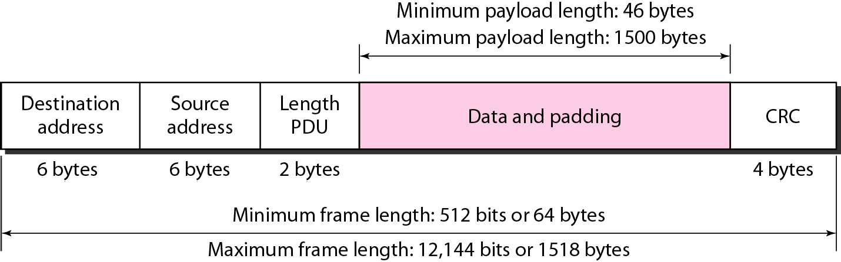
Minimum and maximum lengths

Slide 10

Note
Frame length: Minimum: 64 bytes (512 bits)
Maximum: 1518 bytes (12,144 bits)

Slide 11
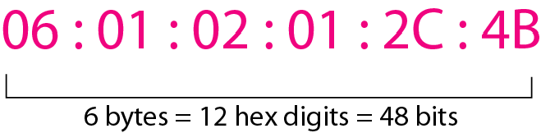
Example of an Ethernet address in hexadecimal notation

Slide 12
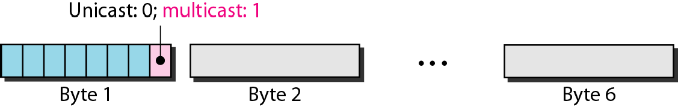
Unicast and multicast addresses

Slide 13
Note
The least significant bit of the first byte defines the type of address.
If the bit is 0, the address is unicast; otherwise, it is multicast.

Slide 14
Note
The broadcast destination address is a special case of the multicast address in which all bits are 1s.

Slide 15
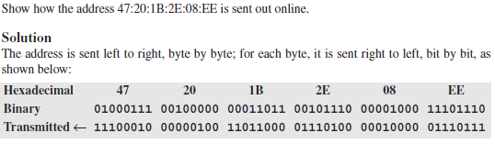
Example

Slide 16

Example

Slide 17
Distinguish Between Unicast, Multicast, and Broadcast Transmission
Transmission in the standard Ethernet is always broadcast,
How it distinguishes??
The answer is in the way the frames are kept or dropped.
Unicast transmission -intended recipient keeps - the rest discard it.
Multicast transmission, members – keeps others - discards
Broadcase tr – all keeps

Slide 18
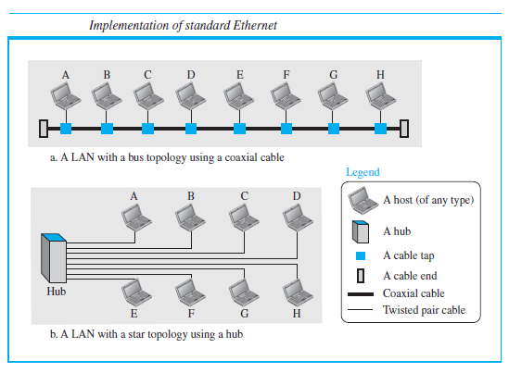

Slide 19
UTP cabling
Category 1—Used for telephone communications. Not suitable for transmitting data.
Category 2—Capable of transmitting data at speeds up to 4 megabits per second (Mbps).
Category 3—Used in 10BASE-T networks. Can transmit data at speeds up to 10 Mbps.

Slide 20
UTP Cabling
Category 4—Used in Token Ring networks. Can transmit data at speeds up to 16 Mbps.
Category 5—Can transmit data at speeds up to 100 Mbps.
Category 5e —Used in networks running at speeds up to 1000 Mbps (1 gigabit per second [Gbps]).
Category 6—Typically, Category 6 cable consists of four pairs of 24 American Wire Gauge (AWG) copper wires. Category 6 cable is currently the fastest standard for UTP.

Slide 21
Access Method
The standard Ethernet chose CSMA/CD with 1-persistent method

Slide 22
Efficiency
The ratio of the time used by a station to send data to the time the medium is occupied by this station.
Efficiency =1 / (1 + 6.4 * a)
“a” is the number of frames that can fit on the medium.
a = (propagation delay)/(transmission delay)

Slide 23
Example

Slide 24
Example

Slide 25
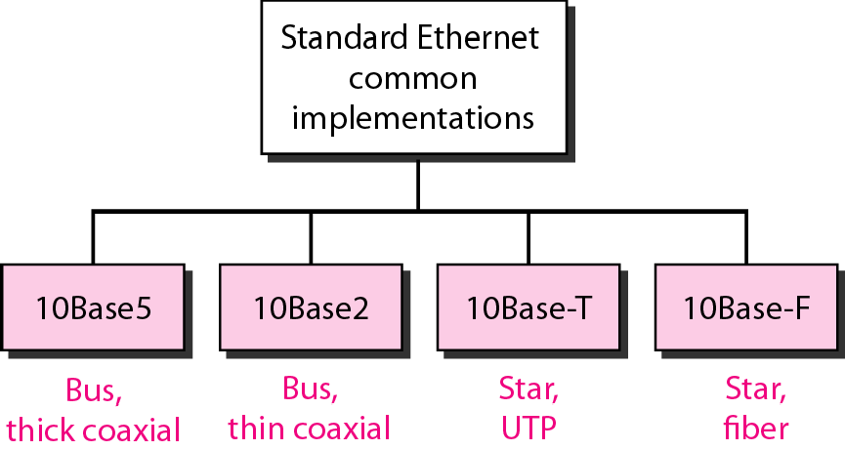
Categories of Standard Ethernet

Slide 26
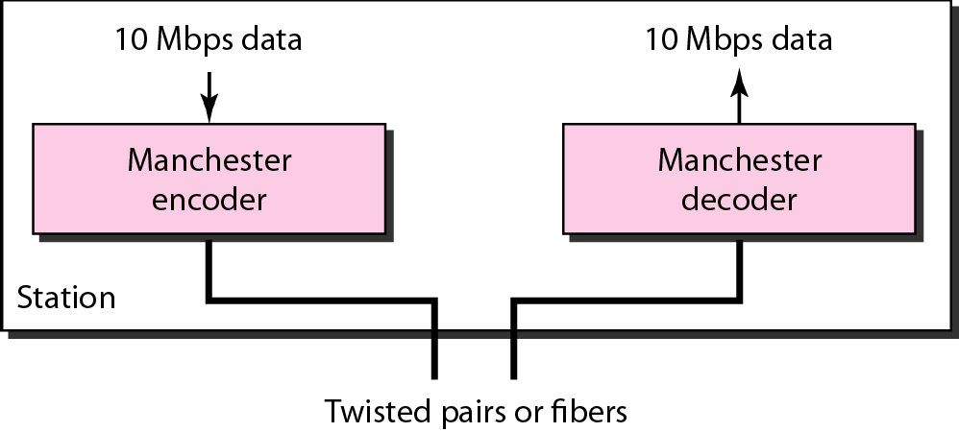
Encoding in a Standard Ethernet implementation

Slide 27
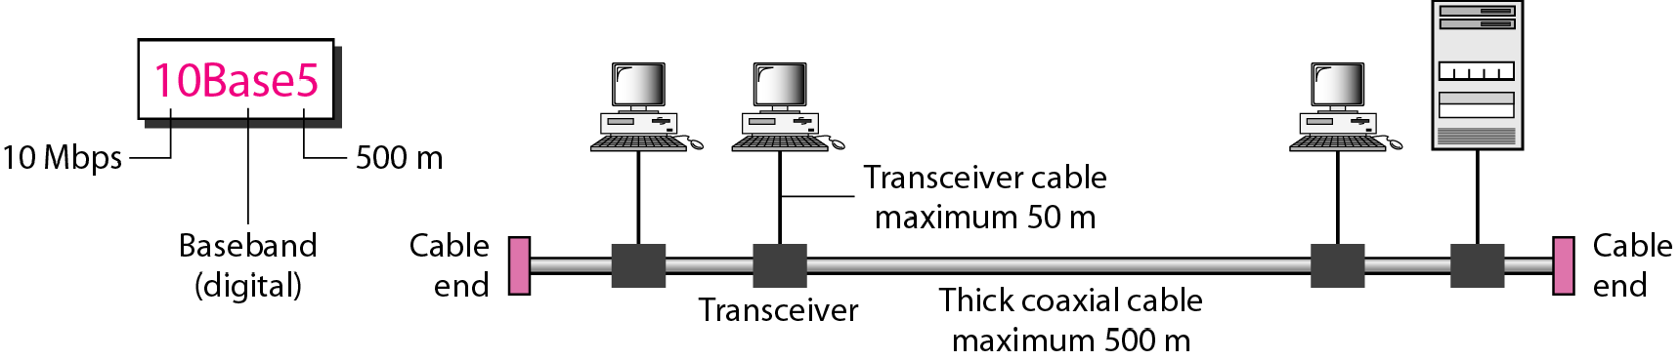
10Base5 implementation

Slide 28
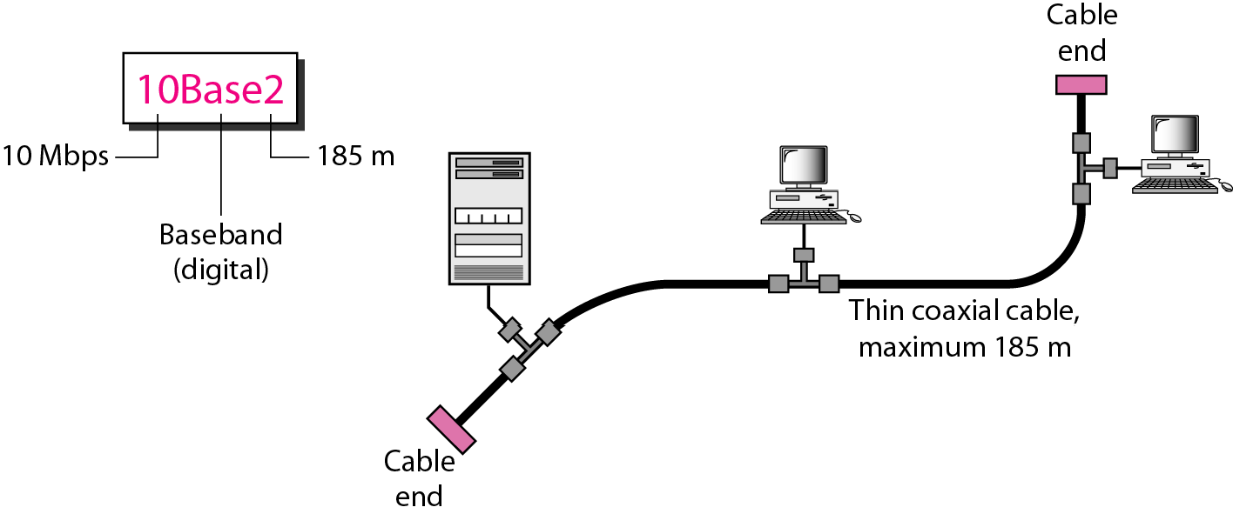
10Base2 implementation

Slide 29
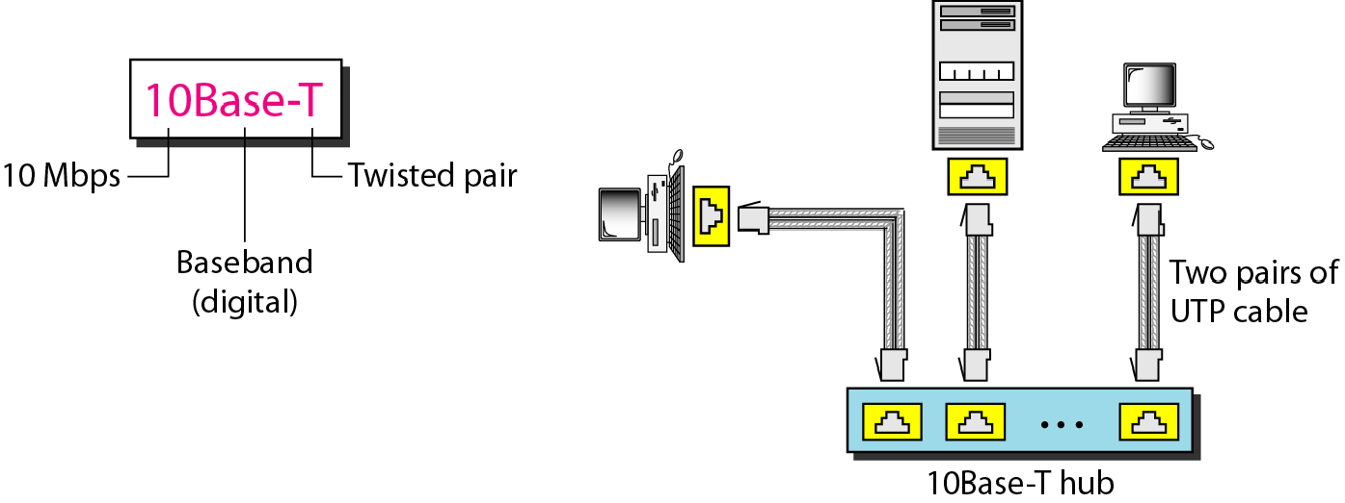
10Base-T implementation

Slide 30
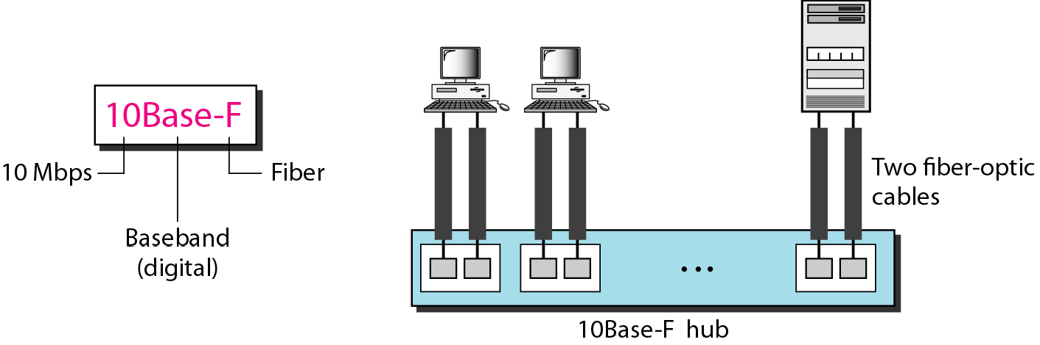
10Base-F implementation

Slide 31
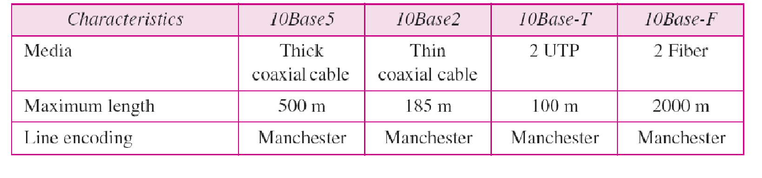
Summary of Standard Ethernet implementations

Slide 32
CHANGES IN THE STANDARD
Raise the bandwidth and separate collision domains
Bridged Ethernet
Switched Ethernet
Full Duplex Ethernet

Slide 33
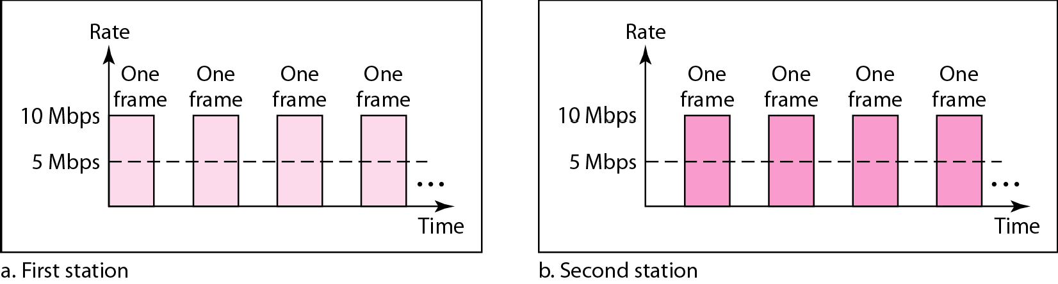
Sharing bandwidth

Slide 34
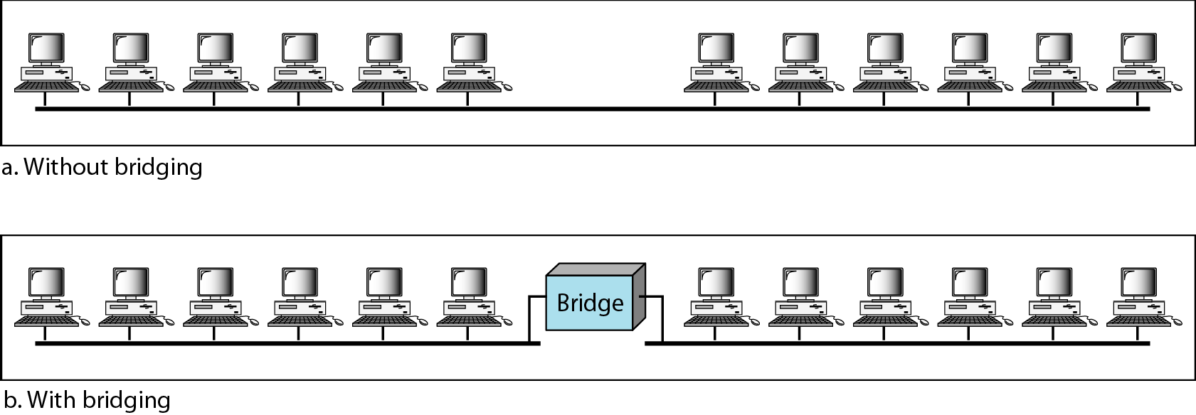
A network with and without a bridge

Slide 35
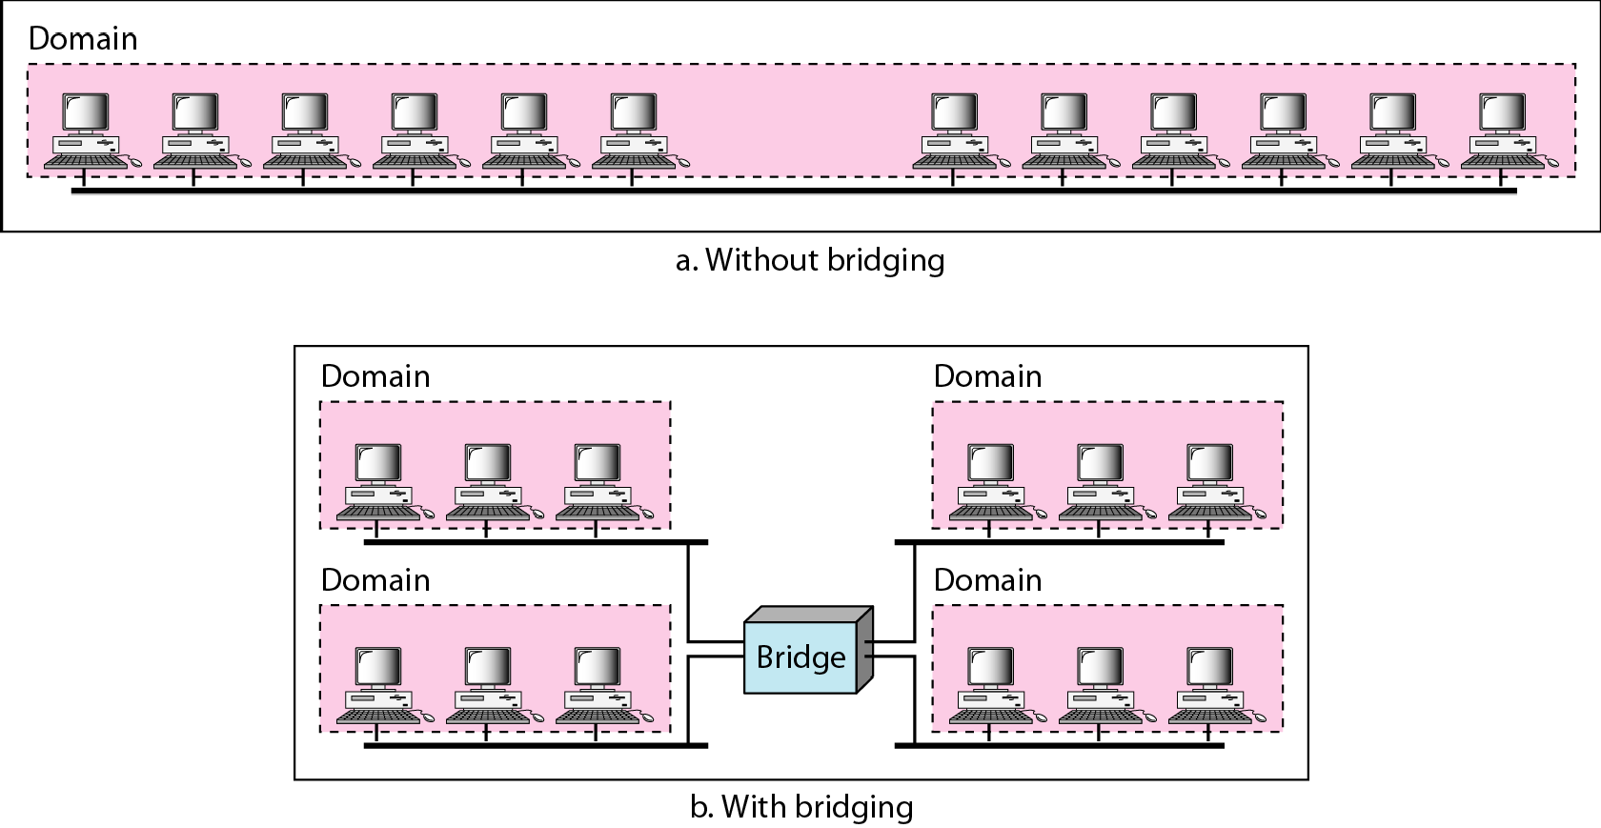
Collision domains in an unbridged network and a bridged network

Slide 36
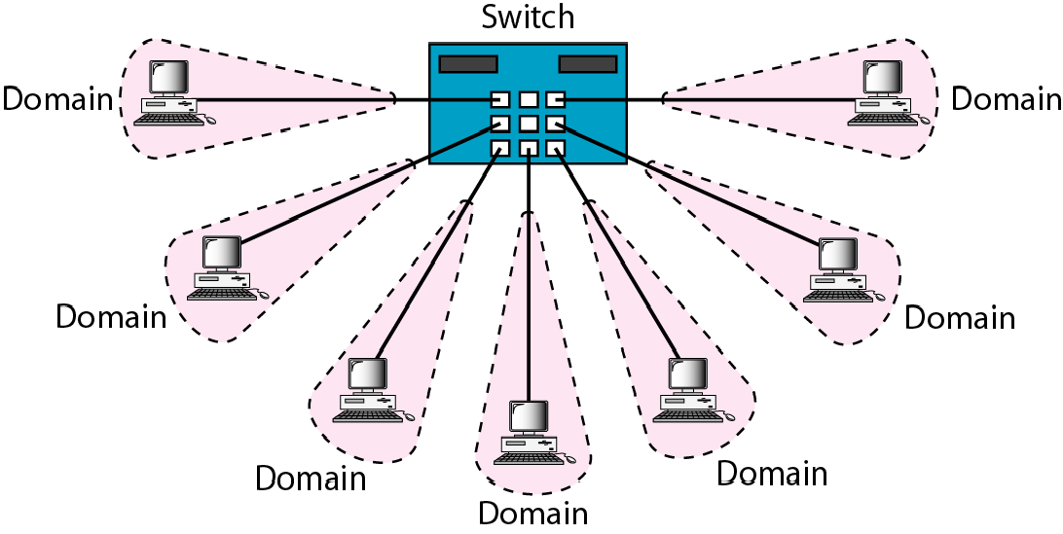
Switched Ethernet

Slide 37
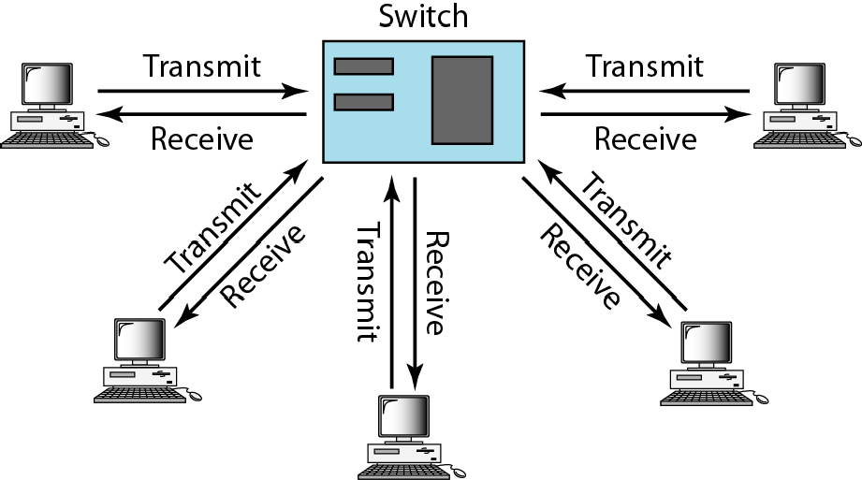
Full-duplex switched Ethernet
No need for CSMA /CD

Slide 38
FAST ETHERNET
Goals
1. Upgrade the data rate to 100 Mbps.
2. Make it compatible with Standard Ethernet.
3. Keep the same 48-bit address.
4. Keep the same frame format.

Slide 39
FAST ETHERNET
Access Method
1. Keep min. frame size then change max. nw length
2. If the minimum frame size is still 512 bits, and it is transmitted 10 times faster, the collision needs to be detected 10 times sooner, which means the max length of the network should be 10 times shorter
Two solutions:
1.Drop the bus topology - use a passive hub and
star topology, max. size of the network -250m instead of 2500m as in the Standard Ethernet - comp with SE

Slide 40
FAST ETHERNET
Second solution:
Use a link-layer switch with a buffer to store frames and a full-duplex connection to each host to make the transmission medium private for each host.
No need for CSMA/CD
Switch receives a frame -stores - (queue) waiting - checks the destination address -sends out
Shared medium- many point to point media- no contention

Slide 41
FAST ETHERNET
Autonegotiation
It allows a station or a hub - negotiate the mode or data rate
Designed particularly to allow incompatible devices to connect to one another.
To allow one device to have multiple capabilities.
To allow a station to check a hub’s capabilities.

Slide 42
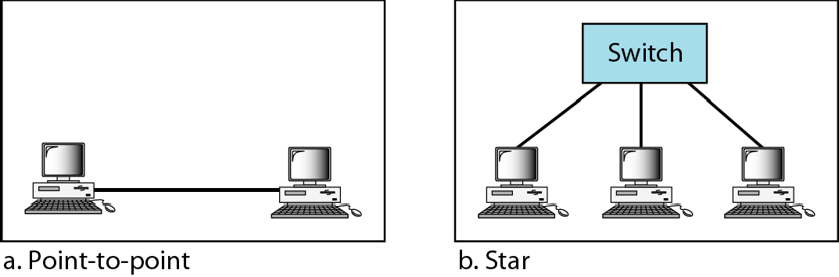
FAST ETHERNET
Physical Layer
Topology : star with hub or switch

Slide 43
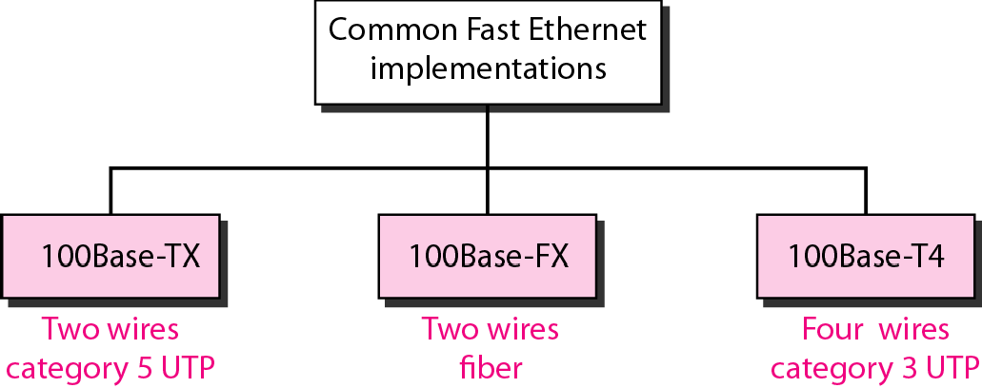
Fast Ethernet implementations

Slide 44
100 Base TX
100Base-TX uses two pairs of twisted-pair cable (either category 5 UTP or STP)
MLT-3 scheme -good bandwidth perf
MLT-3 is not a self-synchronous- 4B/5B block coding- bit synchronization
Data rate of 125 Mbps

Slide 45
100 Base FX
100Base-FX uses two pairs of fiber-optic cables.
NRZ-I encoding scheme -4B/5B block encoding
Data rate from 100 to 125 Mbps

Slide 46
100 Base T4
100Base-T4 - category 3 or higher UTP
Four pairs of UTP -100 Mbps.
Encoding/decoding - 8B/6T
One pair switches between sending and receiving. Three pairs of UTP category 3- 75 Mbaud
(25 Mbaud) each.
In 8B/6T, eight data elements are encoded as six signal elements.
This means that 100 Mbps uses only (6/8) × 100 Mbps, or 75 Mbaud.

Slide 47
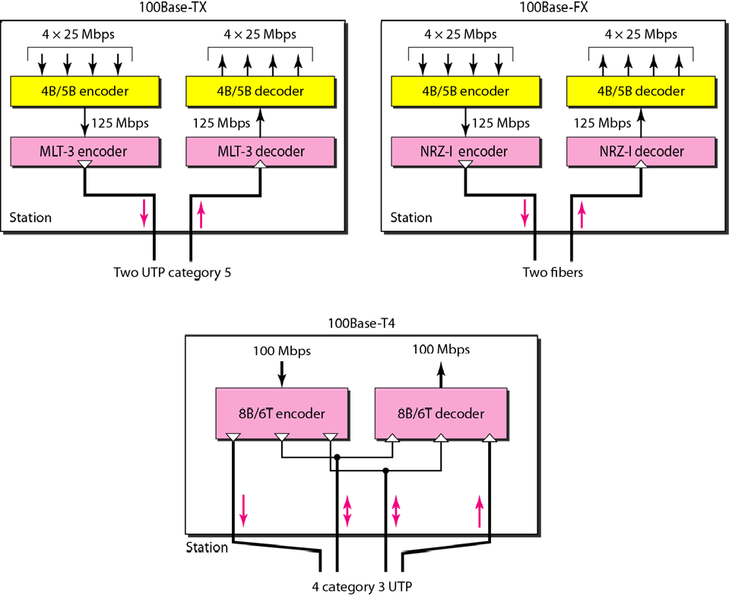
Encoding for Fast Ethernet implementation

Slide 48
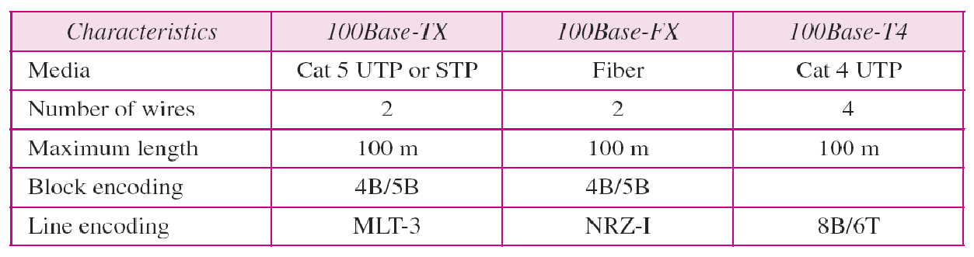
Summary of Fast Ethernet implementations

Slide 49
GIGABIT ETHERNET
Needfo higher data rate -design of Gigabit Ethernet Protocol
1000 Mbps
IEEE -Standard 802.3z.

Slide 50
GIGABIT ETHERNET
1. Upgrade the data rate to 1 Gbps.
2. Make it compatible with Standard or Fast Ethernet
3.Use the same 48-bit address.
4. Use the same frame format.
5. Keep the same minimum and maximum frame lengths.
6. Support autonegotiation as defined in Fast Ethernet.

Slide 51
GIGABIT ETHERNET -MAC Sublayer
Medium Access - two approach
Half Duplex
Full Duplex

Slide 52
Full Duplex Mode
Central switch connected to all computers or other switches.
Each input port, each switch -buffers -stored until they are transmitted.
Switch - destination address -sends a frame out of the port connected to that particular destination -no collision.
CSMA/CD is not used.

Slide 53

Note
In the full-duplex mode of Gigabit Ethernet, there is no collision;
the maximum length of the cable is determined by the signal attenuation in the cable.

Slide 54
Half Duplex Mode
Half duplex -rare
Switch - replaced by hub-common cable in which a collision occur.
Uses CSMA/CD
Maximum length of the network - dependent - minimum frame size
Three methods have been defined: traditional, carrier extension, and frame bursting.

Slide 55
Traditional Approach
Minimum length of the frame - 512 bits
However, because the length of a bit is 1/100 shorter in Gigabit
Maximum length of the network is 25 m.
All the stations are in one room, but it may not even be long enough to connect the computers in one single office.

Slide 56
Carrier Extension
Minimum length of a frame as 512 bytes (4096 bits) - 8 times longer.
Station add extension bits (padding) to any frame that is less than 4096 bits.
Max length of the network - increased 8 times to a length of 200 m.
This allows a length of 100 m from the hub to the station.

Slide 57
Frame Bursting
Carrier extension is very inefficient-short frames to send
Each frame carries redundant data
Instead of adding an extension to each frame, multiple frames are sent.
Padding is added between the frames so that the channel is not idle.

Slide 58
Physical Layer
Topology
Gigabit Ethernet is designed to connect two or more stations.
If there are only two stations, they can be connected point-to-point.
Three or more stations-star topology with a hub or a switch at the center.
Another possible configuration - connect several star topologies or let one star topology be part of another.

Slide 59
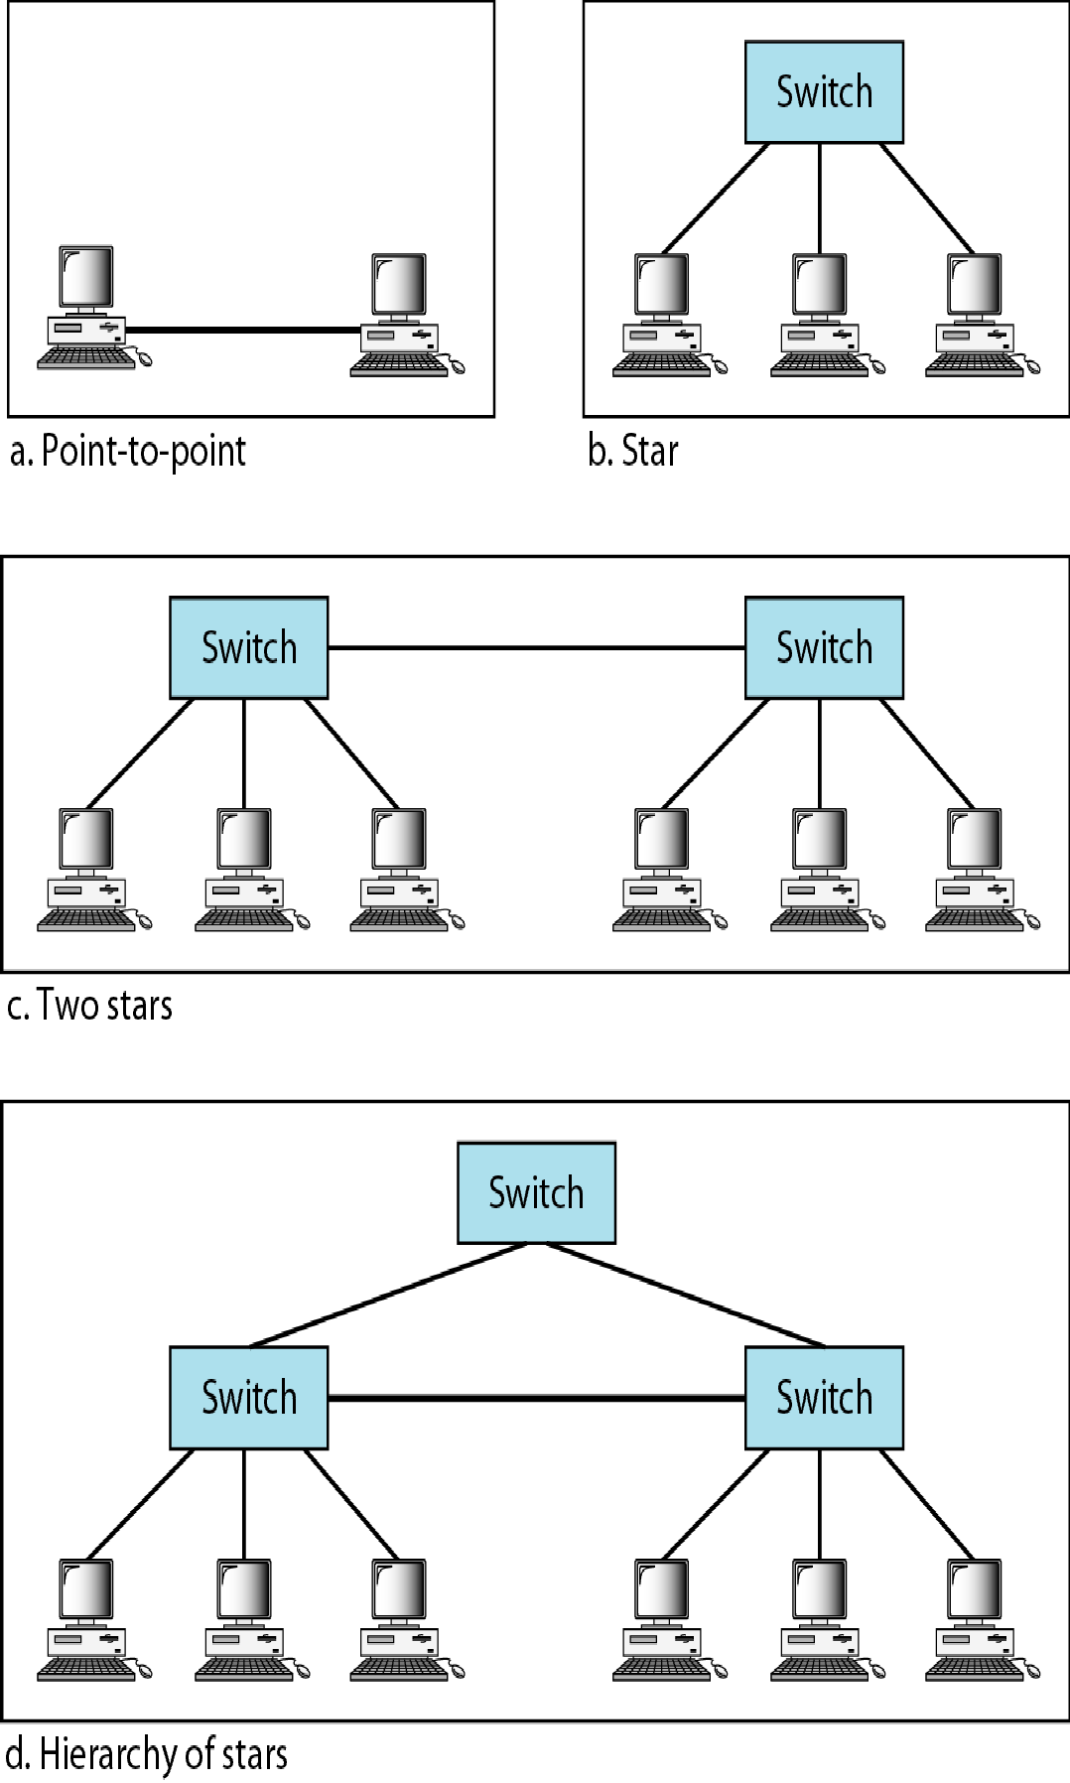
Topologies of Gigabit Ethernet

Slide 60
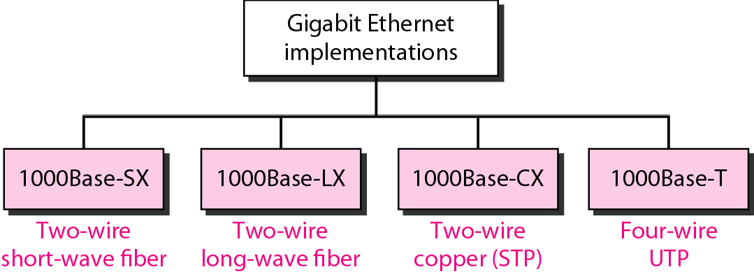
Gigabit Ethernet implementations

Slide 61
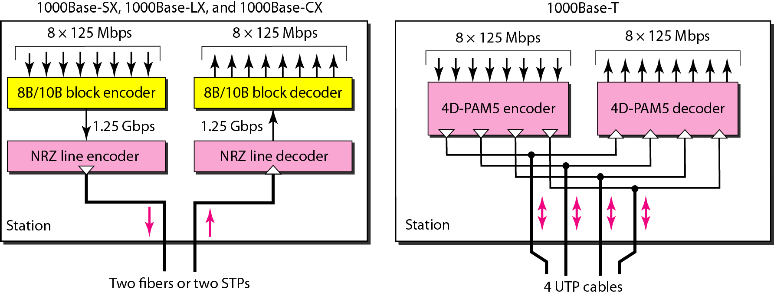
Encoding in Gigabit Ethernet implementations

Slide 62
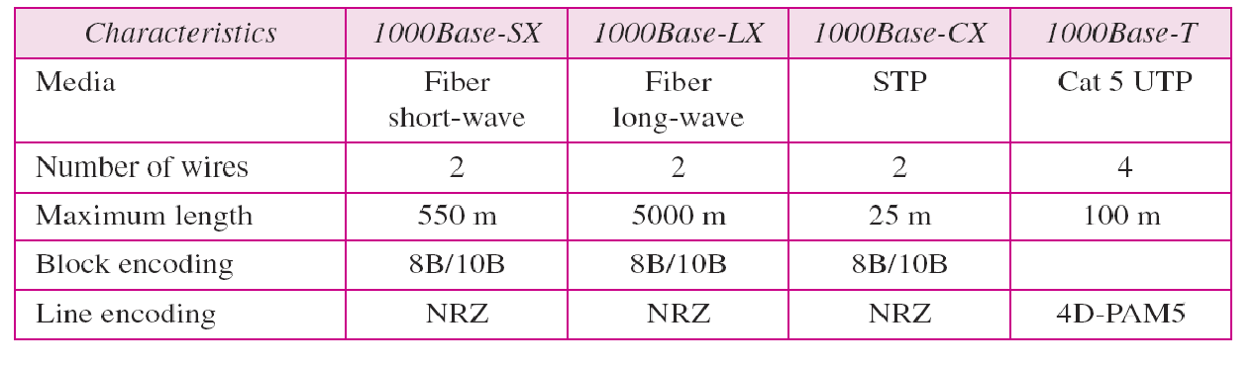
Summary of Gigabit Ethernet implementations

Slide 63
10 GIGABIT ETHERNET
The IEEE committee created 10 Gigabit Ethernet and called it Standard 802.3ae.
Goals
Upgrading the data rate to 10 Gbps, keeping the same frame size and format, and allowing the interconnection of LANs, ANs, and WAN possible.
This data rate is possible only with fiber-optic technology
The standard defines two types of physical layers: LAN PHY and WAN PHY.
The first is designed to support existing LANs; the second actually defines a WAN with links connected through SONET OC-192.
Full duplex mode - no contention

Slide 64
Summary of Ten-Gigabit Ethernet implementations

Slide 65
Check Your Understanding
Why contention not there in Gigabit Ethernet
In carrier extension, what is the minimum frame length?

Slide 66
Outcome
Student should be able to
Explain the various categories of Ethernet technology

Slide 67
THANK YOU

